Slide 1

MARTINA SCHIRONE
SHADOWMAP
COMPUTER GRAPHICS
In this project we implement, within a simple 3D scene, the Shadow Mapping technique for generating shadows.
Page 01

Slide 2

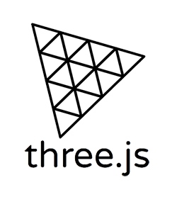
MARTINA SCHIRONE
INTRODUCTION
This project implements the Shadow Mapping technique for real-time shadow generation in a 3D scene developed with WebGL and Three.js.
The scene consists of an isometric room containing two different light sources: a Directional Light and a Point Light.
In addition to traditional Shadow Mapping (Basic Shadow Mapping), the project allows you to compare different algorithms, including Percentage Closer Filtering (PCF) and Variance Shadow Mapping (VSM).
From the UI, you can also modify parameters such as light bias, selectively activate or deactivate lights, graphic helpers, and finally display the shadow depth map using a toggle.
Page 02

Slide 3
MARTINA SCHIRONE
TECHNOLOGIES & RISOURCE USED
IMPLEMENTED FUNCTIONALITIES
Directional Light
Point Light
Interactively change the position of lights
Visualization of the lights helpers.
Adjust the bias
Visualization of the shadow map (depth texture)
Basic Shadow Map
PCF Shadow Map
VSM Shadow Map
SOFTWARE AND FRAMEWORK
WebGL - JavaScript graphic API
Three.js - graphic library
JavaScript - code language
Vite - server build tool
WebStorm - IDE
3D MODELS
Isometric Room - https://skfb.ly/6YEpW
Cube - created from code
Page 03

Slide 4
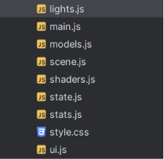
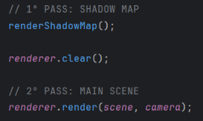
MARTINA SCHIRONE
CODE
IMPLEMENTATION
Thanks to the three.js library the implementation of the shadowmap techniques is fairy simple.
Each JavaScript file is responsible for a specific part of the application:
lights.js – defines and configures the lights in the scene
models.js – loads the room model using GLTFLoader and creates the cube
scene.js – initializes the renderer and the main scene
state.js – contains all UI-related state variables used across the application
ui.js – handles the creation and management of the user interface
shaders.js – sets all the needed shaders for the shadow mapping
main.js – core file that connects all components together and sets up the OrbitControls and render loop.
Page 04

Slide 5
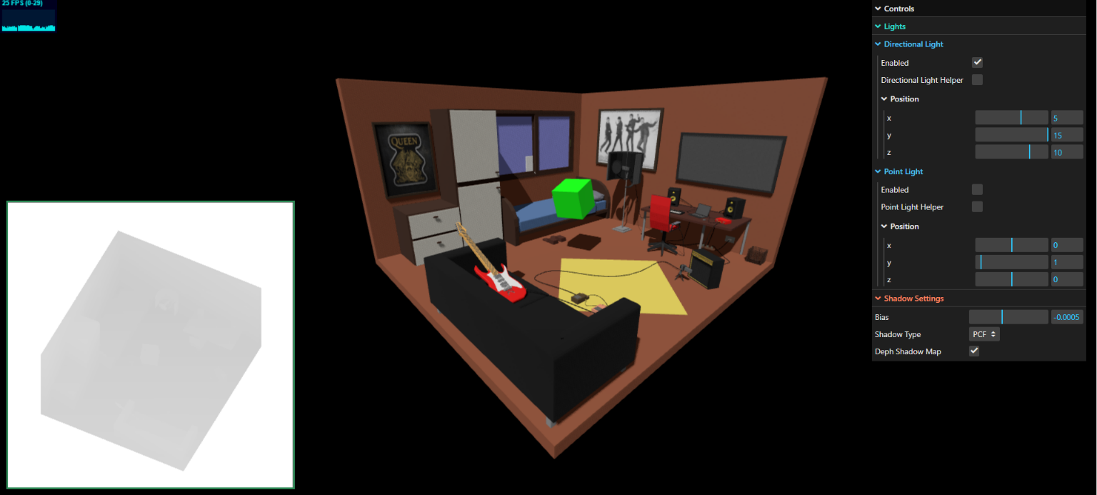
MARTINA SCHIRONE
FULL PROJECT VISUAL
Page 05

Slide 6
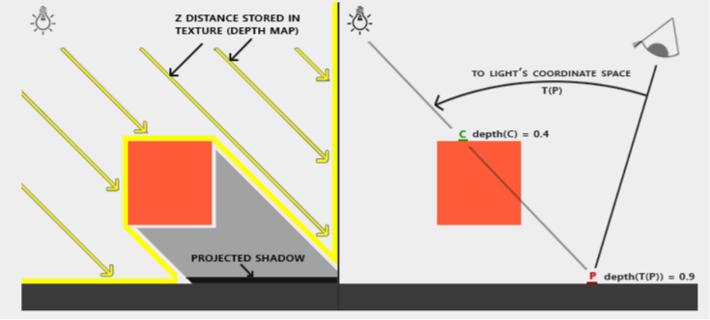
MARTINA SCHIRONE
SHADOWMAPPING
WHAT IS IT?
The main idea is to determine which points in the scene are visible from the light source and which are hidden by other objects.
The rendering process occurs in two steps:
First rendering (from the light's perspective):
We take a picture of the scene from the light source's perspective. The distances of the visible objects from the light are stored in a Depth Shadow Map (depth texture) using a Frame Buffer Object (FBO).
Second rendering (from the camera's perspective):
The scene is rendered normally. For each visible point in the scene, its distance from the light is compared to the value stored in the Shadow Map. If it is further away than the value recorded in the map texel, it means it is hidden by another object and is therefore in shadow.
Page 06

Slide 7
MARTINA SCHIRONE
SHADOWMAPPING TECHNIQUES
BASIC
TRADITIONAL SHADOW MAPPING
PCF
PERCENTAGE CLOSE FILTERING
VSM
VARIANT SHADOW MAPPING
Performs a direct comparison between the fragment's depth and the depth stored in the shadow map texel.
Returns 0 or 1 depending on whether my fragment is in shadow or not.
Shadows generated with this technique have jagged edges and suffer from shadow acne.
It performs multiple shadow map samplings around the texel corresponding to the fragment.
A depth comparison is performed for each sample and the average of the results is returned.
The shadows generated with this technique are softer, but it is more expensive than the basic technique.
Stores the first two depth moments (mean and mean of squares) in the shadow map.
This information is used during rendering to probabilistically estimate the presence of shadow in a fragment, using mean and variance.
Page 07

Slide 8
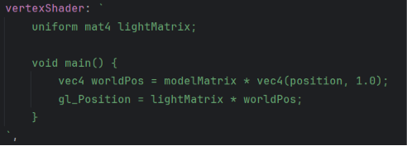
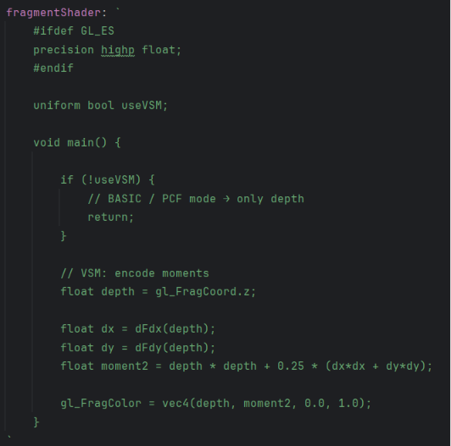
MARTINA SCHIRONE
BASIC
SHADOW MAPPING
Let's take a closer look at how the shadow mapping shaders are coded.
Since there are two rendering passes, automatically four shaders are needed:
Vertex and Fragment Shaders from the 1° rendering,
Vertex and Fragment Shaders from the 2° rendering.
Shown here are the Vertex Shader and Fragment Shader from the 1° rendering, where the depth map is created.
Page 08

Slide 9
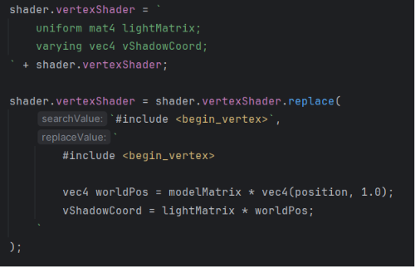
MARTINA SCHIRONE
Here we can see the vertex shader used during the 2° rendering pass.
Since the scene uses a model created by another author, its original Material is preserved.
I extend the original vertex and fragment shaders using onBeforeCompile, a Three.js callback that is executed just before the shader program is compiled.
This allows custom code to be injected into the material original shaders.
This approach preserves Three.js' Physically Based Rendering (PBR) pipeline while adding only the computations required for custom shadow mapping.
Page 09

Slide 10
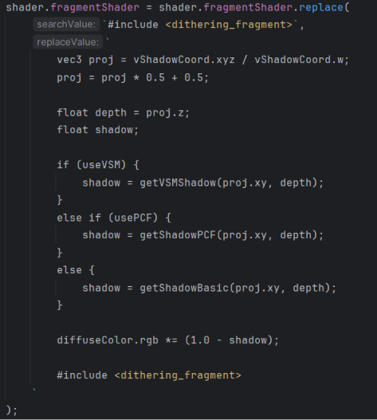
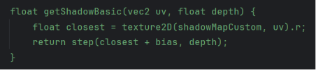
MARTINA SCHIRONE
Here is the Fragment Shader from the 2° render.
The fragment's position relative to the light is normalized (divided by w), obtaining Normalized Device Coordinates (NDC).
These are then converted from the range [-1,1] to [0,1] to access the shadow map and compare depths.
We then check what type of shadow mapping we are implementing and call the relative shader function.
Page 10

Slide 11
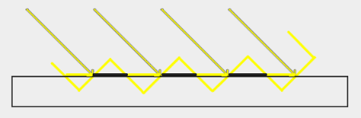
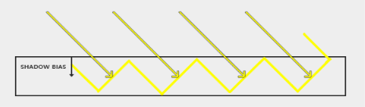
MARTINA SCHIRONE
SHADOW ACNE
& BIAS
One of the major problems with the basic shadow mapping technique, aside from the jagged rendering of shadows, is the so-called shadow acne phenomenon.
Shadow acne is an artifact caused by errors in depth comparisons, caused by the limited resolution of the shadow map, which causes multiple fragments to be compared to the same texel, and by the angle of the light.
One solution to this problem is to introduce a bias, a small tolerance in the depth comparison, to prevent illuminated fragments from being incorrectly classified as shadowed.
Excessive bias, however, can cause the phenomenon of Peter Panning, in which shadows appear visibly separated from the objects that cast them.
Page 11

Slide 12
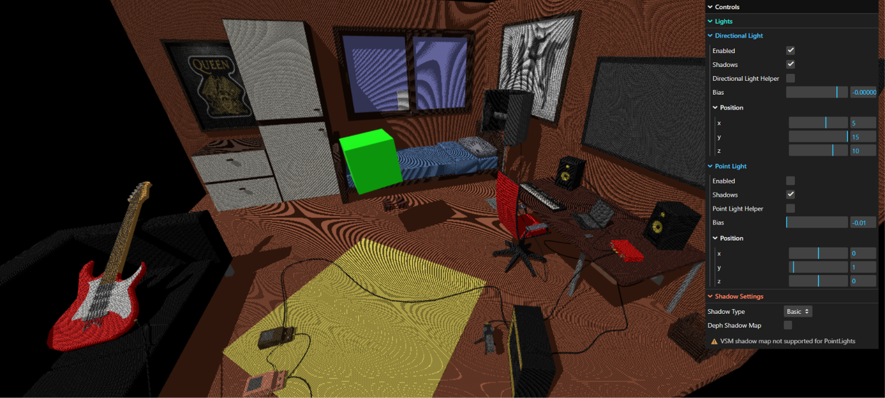
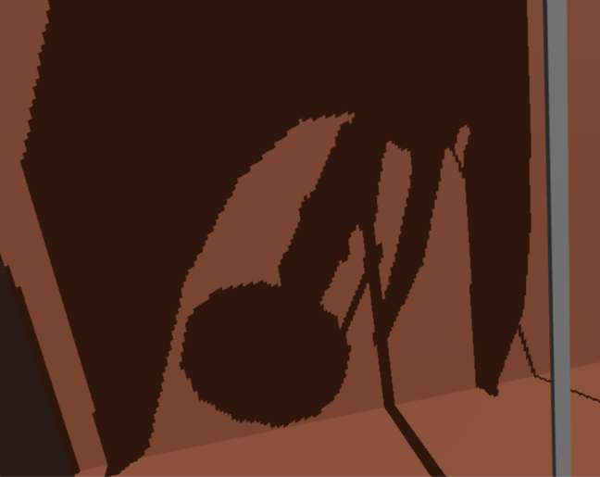
MARTINA SCHIRONE
EXAMPLE OF SHADOW ACNE AND JAGGED SHADOWS
Page 12

Slide 13
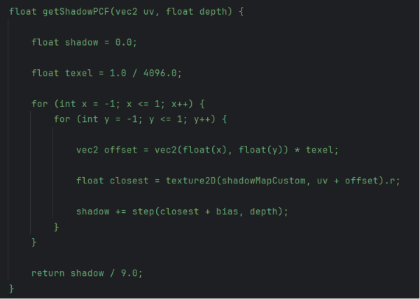
MARTINA SCHIRONE
PCF
SHADOW MAPPING
An extension of Basic Shadow Mapping.
Instead of performing a single comparison between the depth of the fragment and a texel of the shadow map, multiple adjacent texels are sampled (3×3 grid). The depth test is performed for each sample, and the results are then averaged to obtain the final shadow value.
This approach produces softer, more realistic shadows, but introduces a higher computational cost, which further increases as the grid size increases.
Page 13

Slide 14
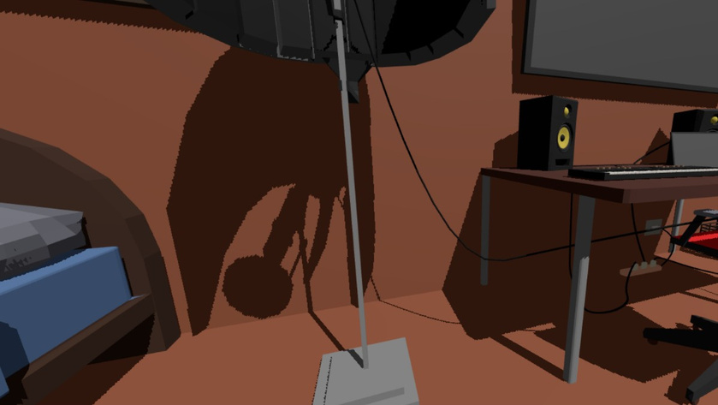
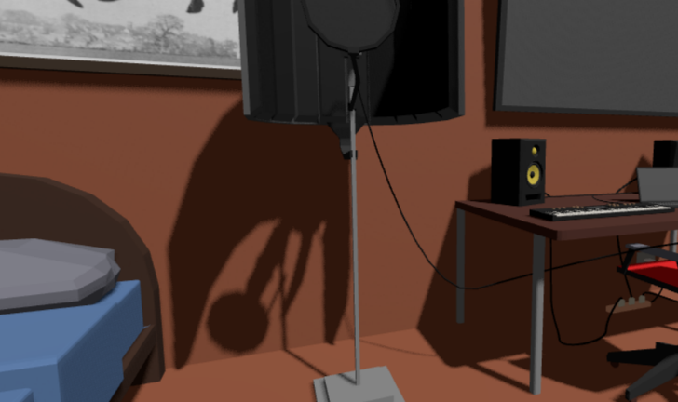
MARTINA SCHIRONE
VISUAL EXAMPLE OF PCF AND BASIC SHADOW MAPPING
BASIC
PCF
Page 14

Slide 15



MARTINA SCHIRONE
VSM
SHADOW MAPPING
Unlike Basic Shadow Mapping and PCF, this technique does not store only depth values in the shadow map.
For each texel, the first two moments of depth are stored:
Mean depth: E[x]
Mean squared depth: E[x²]
During rendering, these values are used to compute variance and estimate shadowing using Chebyshev’s inequality.
This approach introduces additional computational overhead due to variance evaluation but the results are very satisfying.
A known limitation is light bleeding, where light incorrectly leaks into areas that should be fully in shadow.
Page 15

Slide 16
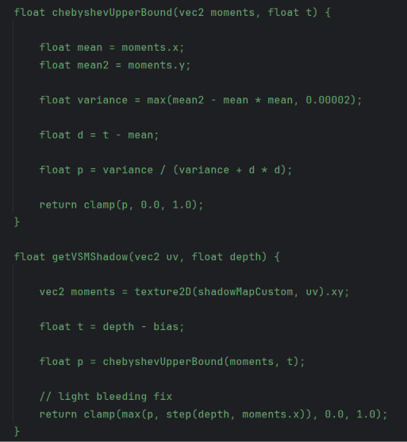
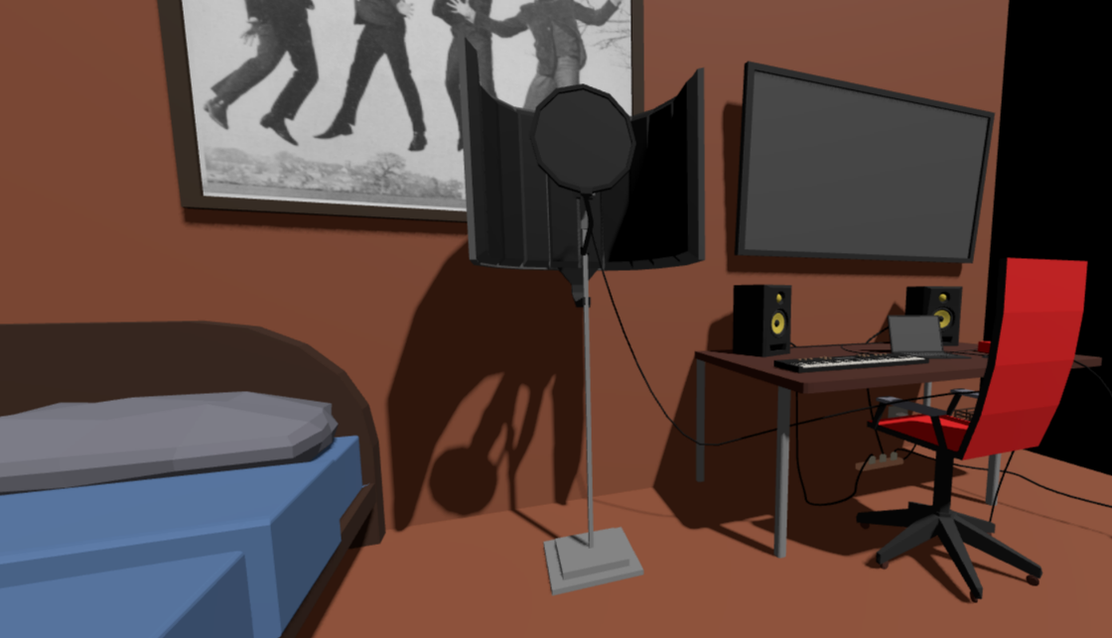
MARTINA SCHIRONE
VSM SHADER AND VISUAL EXAMPLE
Page 16

Slide 17
MARTINA SCHIRONE
SHADOWMAPPING TECHNIQUES
COMPARISON OVERVIEW
Basic Shadow Mapping is fast but produces aliased shadows. PCF provides a balanced trade-off between performance and quality. VSM delivers the best visual quality but at a higher computational cost.
TYPE | PROS | CONS | FPS
BASIC | Very light to compute | Jagged edges, shadow acne | 60
PCF | Smooth shadows | Medium cost | 44-55
VSM | Very smooth shadows | Light bleeding, higher cost | 35-38
Page 17

Slide 18
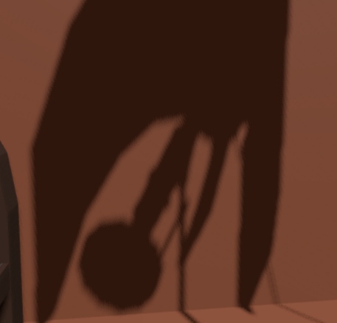
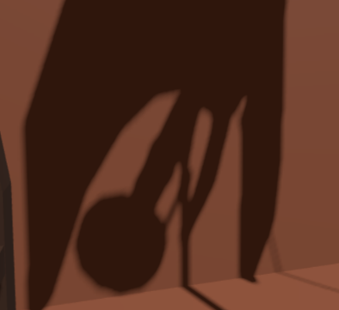
MARTINA SCHIRONE
SHADOWMAPPING TECHNIQUES
COMPARISON OVERVIEW
BASIC
PCF
VSM
Page 18

Slide 19
MARTINA SCHIRONE
THANK YOU

